Slide 1
Convolutional and recurrent neural networks
By: Shyam Rajendren

Slide 2
Convolutional Neural Networks

Slide 3
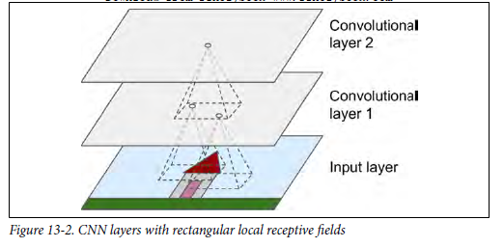
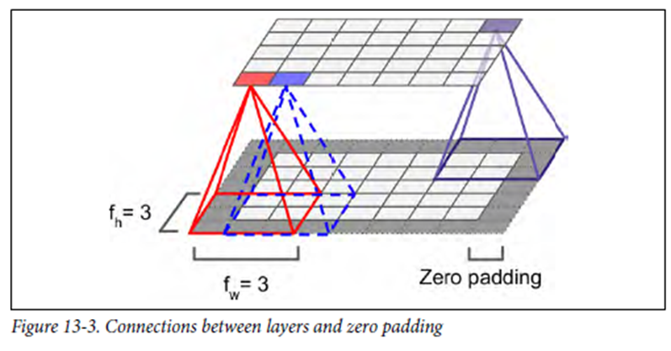
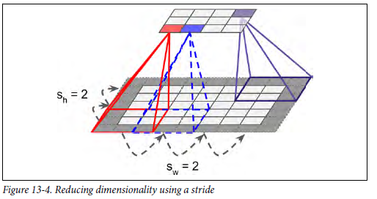
Convolutional layer

Slide 4
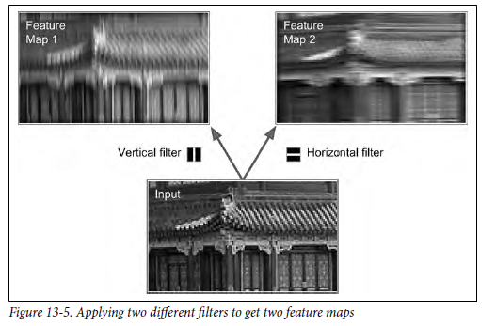
filters

Slide 5
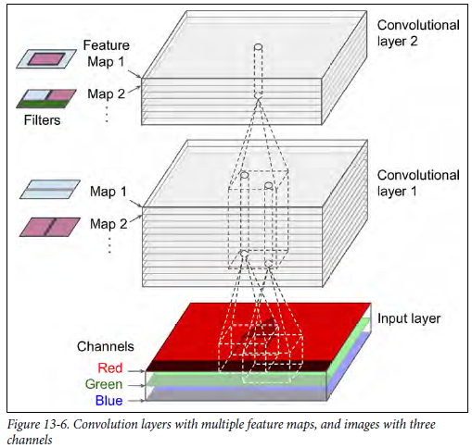
Stacking multiple feature maps

Slide 6
TensorFlow implementation

Slide 7
Memory requirements

Slide 8
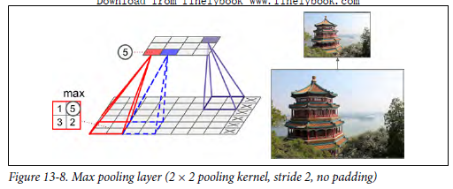
Pooling layer

Slide 9
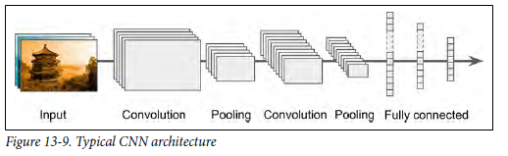
Cnn architectures

Slide 10
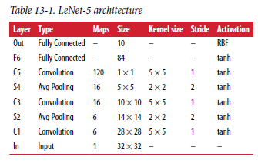
Lenet-5

Slide 11
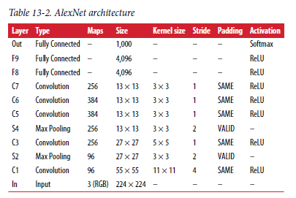
alexnet

Slide 12
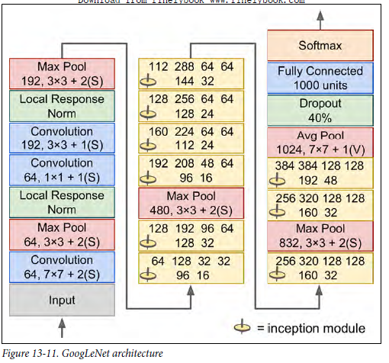
googlenet

Slide 13
resnet

Slide 14
recurrent Neural Networks

Slide 15
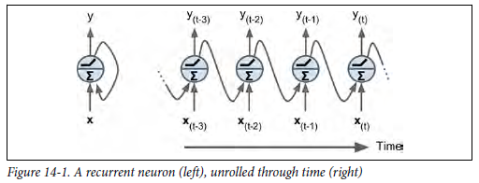
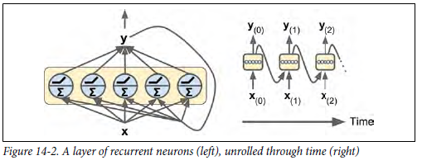

Recurrent neurons

Slide 16
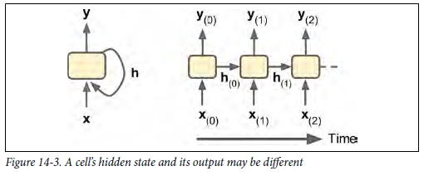
Memory cells

Slide 17
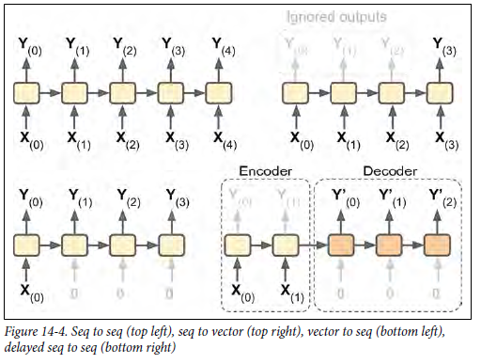
Input and output sequences

Slide 18
Handling variable-length output sequences

Slide 19
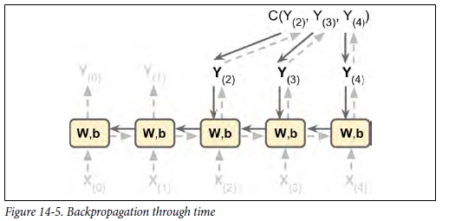
Training rnns

Slide 20
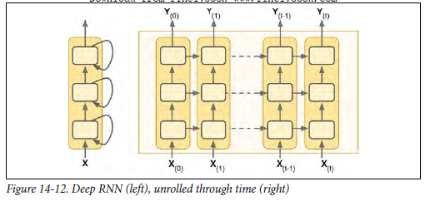
Deep rnns

Slide 21
Applying dropout

Slide 22
The difficulty of training over many steps

Slide 23
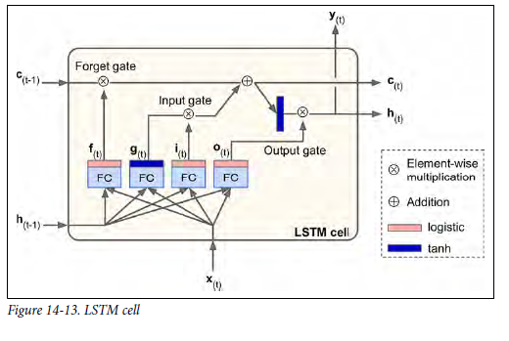
Lstm cell

Slide 24
Peephole connections

Slide 25
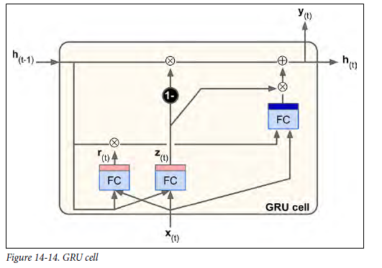
Gru cell

Slide 26
Natural language processing

Slide 27
Word embeddings

Slide 28
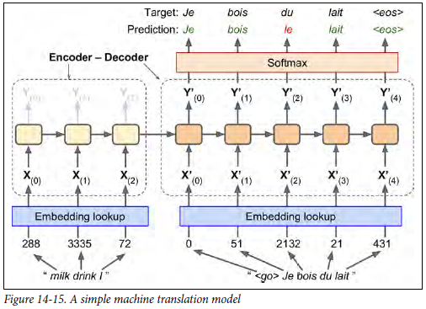
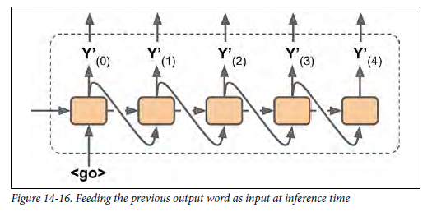
An encoder-decoder network for machine translation

